Slide 1
Cereal nutrition analysis using r
Suneeth Ravilla
Bowling Green State University

Slide 2
About dataset
Nutrition data on 77 cereal products with 16 variables
Name of cereal
Manufacturer of cereal (7 manufacturers)
Type: Hot or Cold
Nutrition factors like calories, protein, fat, sodium, fiber, carbohydrates, sugars, potassium, vitamins and minerals (0, 25, or 100), weight, cups.
display Shelf (1, 2, or 3, counting from the floor)
Rating (0-100) – Target Variable
Ratings are divided into 3 groups,
Group 3 – Ratings less than 35
Group 2 – Ratings between 35 and 54
Group 1 – Ratings greater than 54

Slide 3
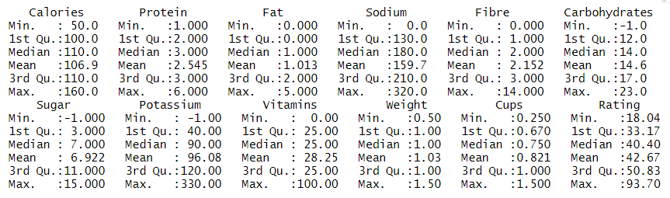
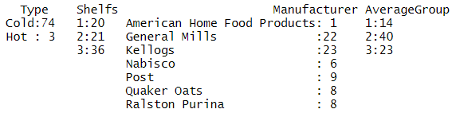
Data summary
Average user Rating of the cereal is 42.67
General Mills and Kellogg's are producing different type of cereals than other 5 manufacturers
Most of the cereals are placed on Shelf 3 assuming Shelfs are decided based on age group and height
Cold consumption of cereal are more in number with 74
On average, calories per serving is 107
Average Group 2 contains more number of data with 40 records

Slide 4
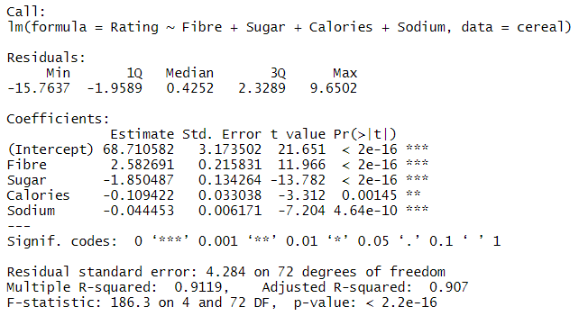
REGRESSION
Considering Rating as the target variable.
All the variables are assumed. Later upon step-wise regression we left with 4 variables.
Fibre, Sugar, Calories, Sodium are the factors effecting the Rating of the product.
Adj R-squared is 0.9 which shows this model can be used to predict Rating for other cereals.
Regression model output,
Rating = 68.71 + (Fibre) 2.58 – (Sugar) 1.85 – (Calories) 0.10 – (Sodium) 0.04

Slide 5
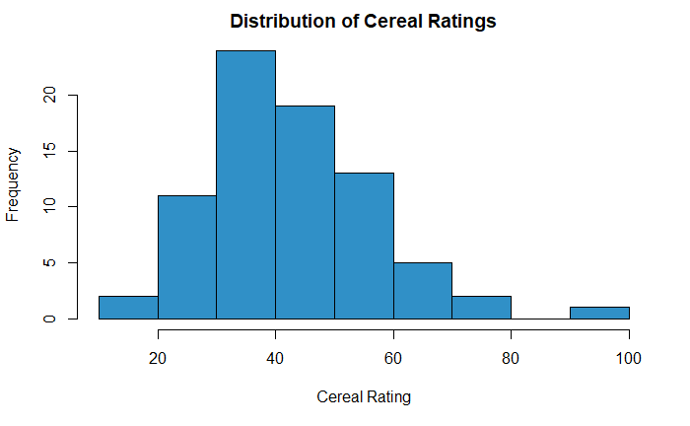
Distribution
Ratings of all the products are distributed towards right causing right skewed distribution
Most of the ratings fall between the range of 30 and 50
This shows on average the customer is neither satisfied nor unhappy with the product

Slide 6
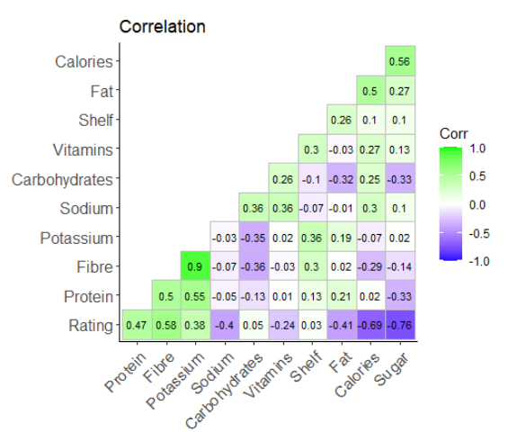
CORRELATION
Considering Rating, Sugar and Calories are highly correlated negatively with 0.76 and 0.69 respectively
Fibre is positively correlated with Rating with correlation value of 0.58
Considering other variables, Fibre and Potassium are highly correlated with 0.9

Slide 7
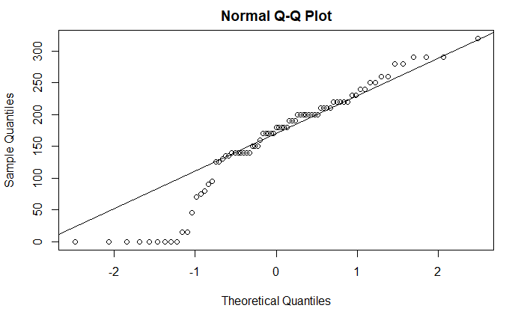
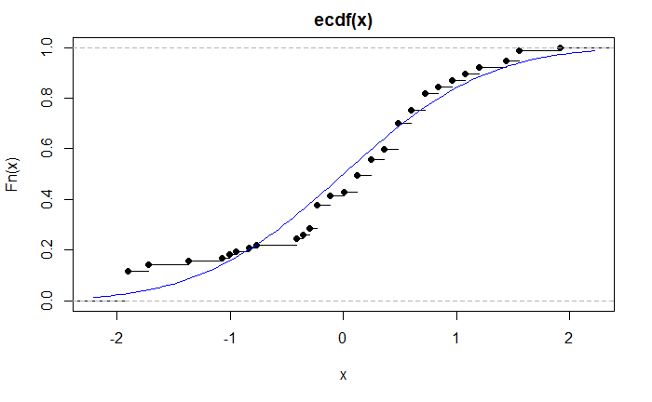
Normality
Normality assumption is performed on Sodium variable.
The points lie along the Q-Q Line of the normal distribution with skewness below 0.
Considering normality of ECDF plot, the data points fit through the curve which seems to have normal above zero but below zero we can see the skewness.

Slide 8
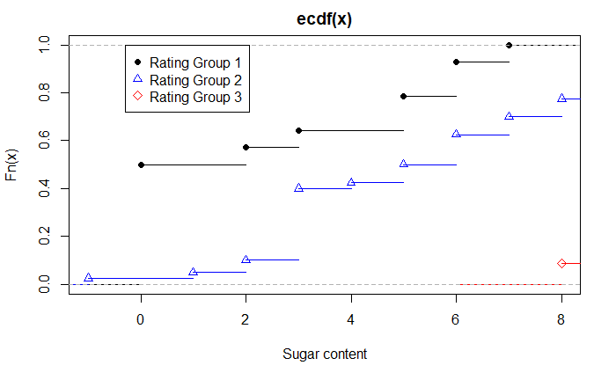
ECDF PLOT
From ECDF plot we can see that Group 3 contains a high number of sugar content than other two
Sugar content in Group 2 is almost normally distributed
When considered sugar content at 7 and above we can see more number of products with high content of sugar in Group 2 and 3

Slide 9
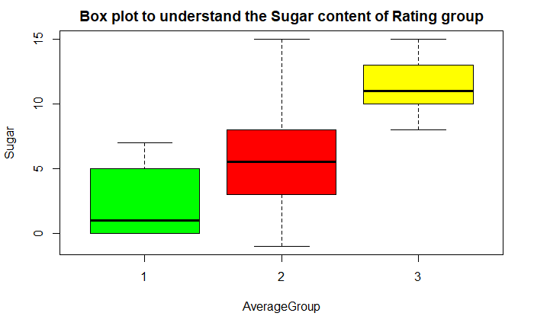
BOX PLOT
Box plot shows the clear representation of Rating Group with Sugars
Group 3 which has lowest number of ratings has high amount of sugars with very less standard deviation.
Group 1 which have more number of ratings has low sugars but it has high variation in the data.

Slide 10
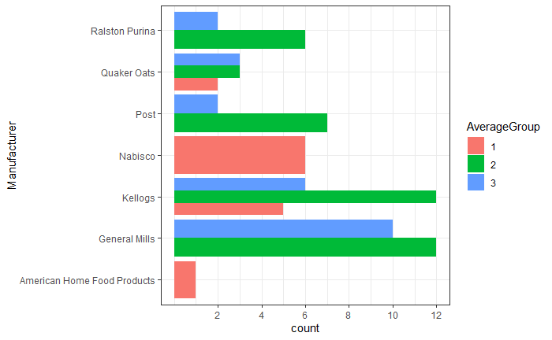
Manufacturer vs shelf
Focusing on count only two manufacturers, Kellogs and Quaker Oats are fallen under 3 groups of average.
Out of 23 products of General Mills 10 products ratings are below 35 which is poor
Kellogs and General Mills has same number of products in group 2 with 12 each
But Nabisco and American Food is exception, it has all its products in group 1 which is highest rating group of the data.
Kellogs has 7 products in group 1 but General Mills failed to have single product rating over 54
Let's perform K Means clustering for better results.

Slide 11
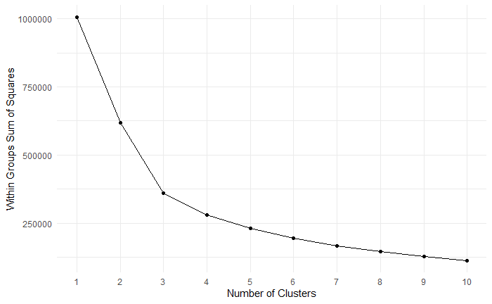
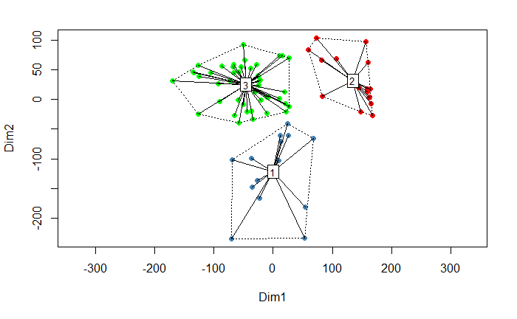
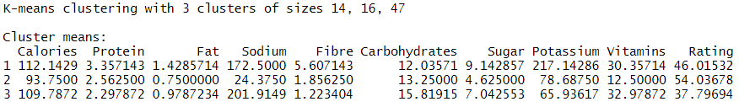
K- MEANS CLUSTERING
For choosing right amount of clusters, performed Sum of Squares of the distances of each data point in the cluster to their centroid.
From elbow point graph, the optimal k value for the cluster is chosen as 3
The sizes of 3 clusters are of 14, 16 and 47
We can see more number of data in cluster 3 with average Rating of 37.7
Highest average Rating is obtained in cluster 2 with 54 which is not so good but better than the average Rating of the complete dataset.
We can observe less amount of sugar and calories in cluster 2

Slide 12
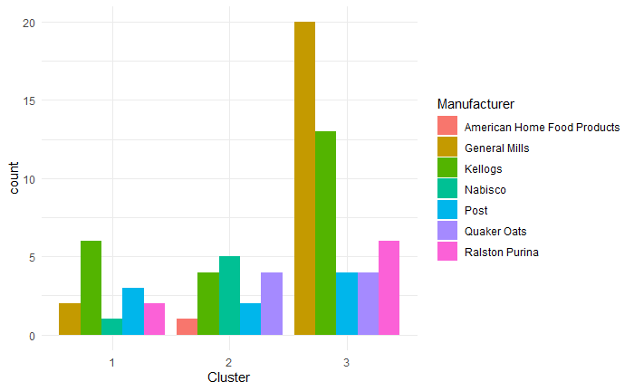
CLUSTER ANALYSIS
Performed analysis on the output of the cluster with Manufacturer
We can observe out of 7, 5 Manufacturer lie in cluster 3 which we mentioned as less Rating earlier.
Manufacturer like Nabisco and American is in cluster 2 which has better rating and less sugars.
Even though General Mills has multiple products it failed to gain spot in better ratings cluster.

Slide 13
CONCLUSION
Rating can be predicted with the variables Fibre, Sugar, Calories and Sodium.
Average Cereal Rating is 42.6
Potassium is highly correlated with Fibre, but Calories and Sugar are correlated with Rating.
Group 3 contains high amount of sugars based on ECDF plot but on average it also has less ratings.
Almost all the manufacturer products are in Group 2 and 3 except Nabisco who seems to focus on Ratings.
Sodium variable seem to follow the normality assumptions with slight skewness.
Data is clustered into 3 groups using K-Means Clustering and on average 3rd cluster has more data with least average of rating than other two clusters.
Analyzing clusters with manufacturer we can see Nabisco and American Home stands Cluster 2 which has better Rating and on average contains less amount of sugar.

Slide 14

THANK YOU
ANY QUESTIONS?

